Slide 1
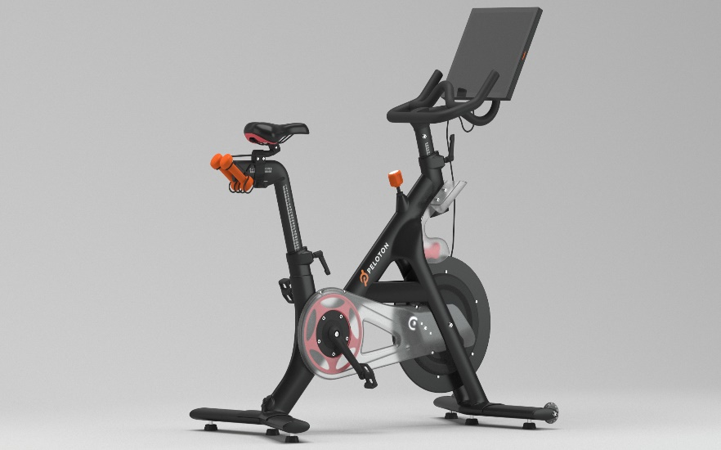
Peloton Bike (Ziyang He & Tianxing He)
Unfriendly Design
Restrictions on connecting to the power supply
The interface is complex
It takes a lot of time to assemble
The seat cannot be adjusted
Difficult to handle sweat
Possible Solution
Increase icon size to reduce unnecessary screen space in the system
Simplify the interface and add more guidance
Change the seat to an adjustable seat
Add sweat absorption or waterproof measures

Slide 2
Hexoskin Smart Shirt (Jingcheng Li & Tianxing He)
Unfriendly Design
Binding user actions
Complex ways to pair with other devices and hard to dress
Difficult to understand data reporting
Possible Solution
Provide more options for adaptation, such as adjustable shoulder straps or belts
Provide simpler pairing and setup processes, data reporting forms, and some detailed instructions and live video demonstrations
Integrate with other devices, such as providing voice broadcasting

Slide 3

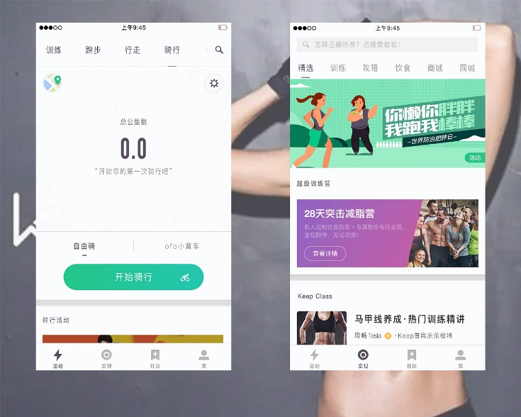
Keep (Xi Kong)
Unfriendly Design
Lack of customization and personalization options
Lack of tracking users’ exercise
Possible Solution
Provide personalized fitness guidance
Provide some functions that can monitor users’ exercise
Combined with hardware, such as launching patches that can sense muscle electrical signals to assist users in fitness

Slide 4
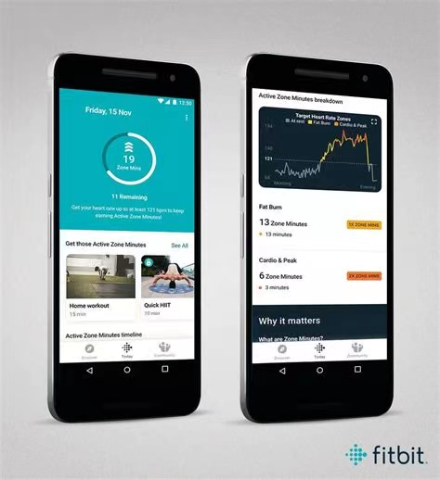
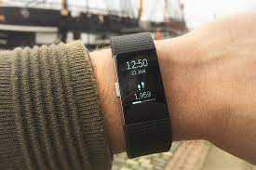
Fitbit Charge 2 (Xinyuan Zhang)
Design Principles violated
Visibility of system status
No feedback for "off" or "tracking"
Long time blank screen
User control and freedom
No consideration of pause
Improvement
Literature
Give feedback through vibrations
Add prompt words about the status
Add tap-to-pause option
Interview
Observation

Slide 5
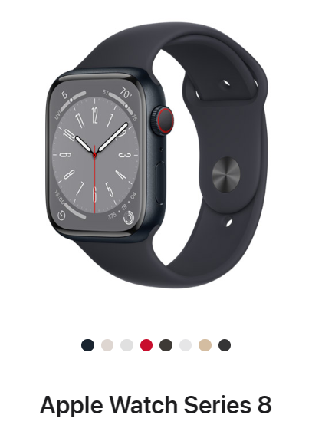
Apple Watch Series 8 (Yifei Shen)
Unfriendly Design
Unable to provide users’ exercise status and progress clearly
Unable to monitor users’ movement posture
The design is too complex and the functions are too general
Possible Solution
Provide larger font, high-contrast colors or function to adjust interface size
Interact with other devices to provide monitoring services(Voice alarm when necessary)
Provide personalized, user schedule based exercise plans

